Slide 1
Plate Tectonics Lab Discussion
Fruit Rollup and Graham Cracker

Slide 2
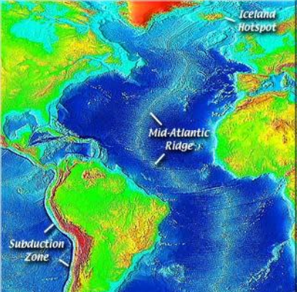
Divergent Boundaries
Mid-Ocean Ridges – two oceanic plates pull apart. The result is a mid-ocean ridge, such at the Mid-Atlantic Ridge.

Slide 3
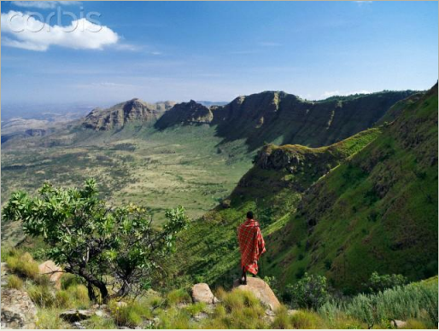
Divergent Boundaries
Rift Valleys – two continental plates pull apart. The result is a rift valley, such at the Great Rift Valley in Africa.

Slide 4
Subduction
Definition: One tectonic plate moves under another tectonic plate, thus sinking into the mantle, as the plates converge.

Slide 5
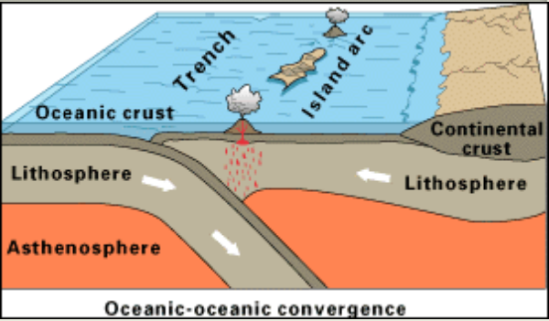
Convergent – Oceanic/Oceanic
When an oceanic plate pushes into and subducts under another oceanic plate, the overriding plate is lifted up and an island arc can be created
Example: Aleutian Islands
of Alaska

Slide 6
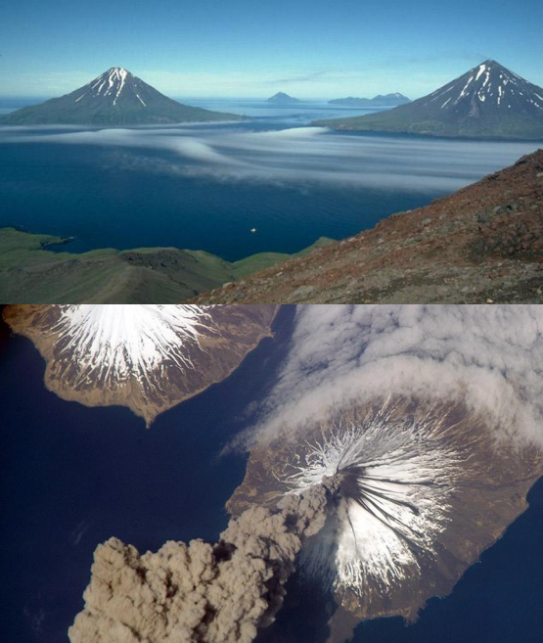
Aleutian Islands
Islands created by
oceanic to oceanic
convergent plates

Slide 7
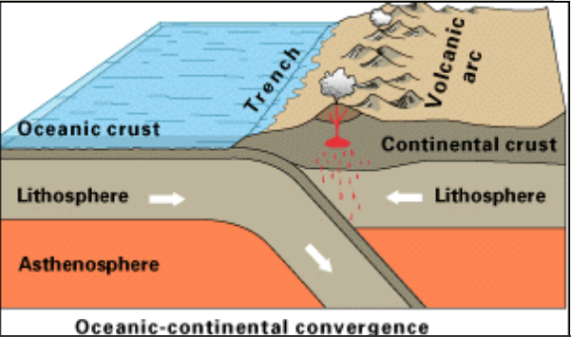
Convergent – Oceanic/Continental
When an oceanic plate pushes into and subducts under a continental plate, the overriding plate is lifted up and a volcanic mountain range can be created
Example: Andes Mountains In South America

Slide 8
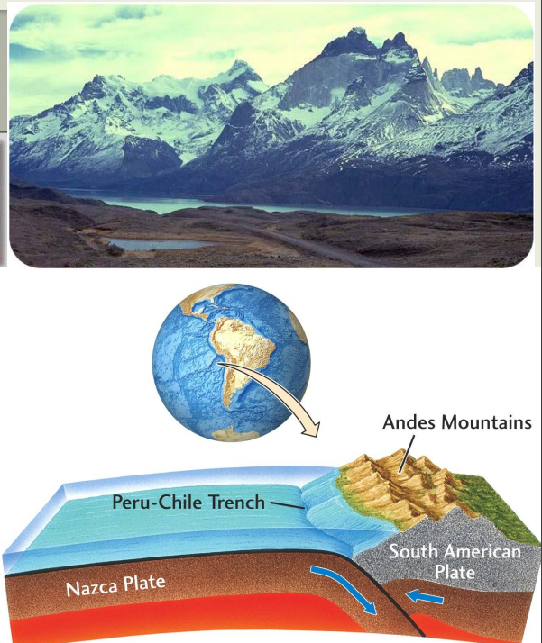
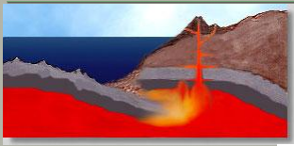
Andes Mountains
Volcanic Mountains created by convergence of oceanic to continental plates

Slide 9
Continental-Continental Convergence
When two continents meet or collide head-on, neither plate is subducted because the continental rocks are relatively light
Instead, the crust folds and buckles.
The collision of India into Asia 50 million years ago caused the mountains known as the Himalayans.

Slide 10
Himalaya Mountains

Slide 11
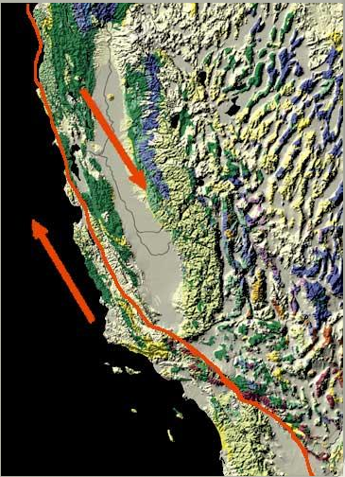
Transform Boundaries
Transform Boundaries are where two plates are sliding horizontally past one another.
When the two plates slide past each other, energy builds up and when released, the stress and pressure of this movement can cause an earthquake.
Example: The San Andreas Fault in California

Slide 12
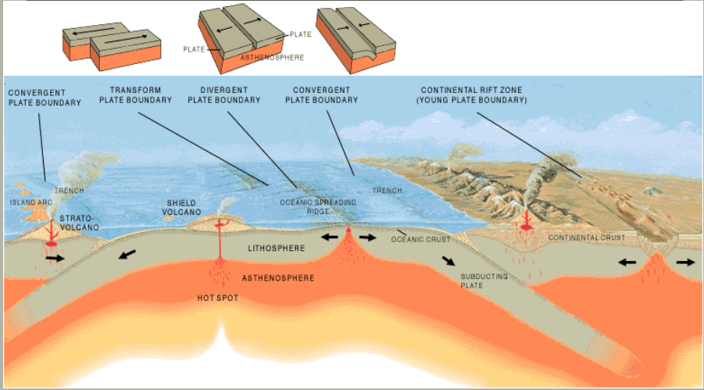
Plate Boundaries

Slide 13
Follow-Up Questions
Title your page “Follow Up: Tectonics Lab” and write down the questions and answers in your journal after Thursday’s lab:
How do the movements of tectonic plates cause geological events?
How are convergent plates different from divergent plates?
What are some features on Earth that are caused by plate movement? (list at least two)
Explain, in your own words, what happens during the process of subduction.

